Slide 1
WEEK 12
Victorian Period, writers, works

Slide 2
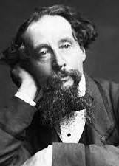
CHARLES DICKENS
1812-1870

Slide 3
Popular works
The Old Curiosity Shop 1841
Barnaby Rudge 1841
Martin Chuzzlewitt 1843
Dombey and Son 1849
David Copperfield
Bleak House 1853
Hard Times 1854
Little Dorritt 1857
A Tale of Two Cities 1859
Great Expectations 1861

Slide 4
Dickens’s fiction and common themes in his works
Loneliness of childhood, caused by the heavy work of industrial revolution.
  What was life like for Victorian children? Many children went to work, not to school.
Oppression of poverty
Uncertainty of love and marriage
Indifference of social institutions
Sustaining joy of family life
Perseverance and sacrifice in face of untold hardships and injustice
Many autobiographical links between life and writings

Slide 5
Dickens’s art of writing
Satire and criticism of society
Social realism
Many autobiographical elements
Picaresque novel
Melodramas of the 18th century sentimental writing
Gothic elements inside his plots etc.
City life: London, back streets

Slide 6
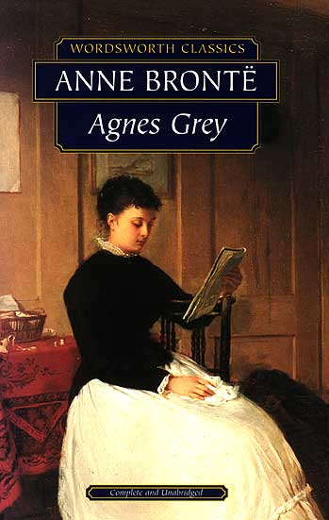
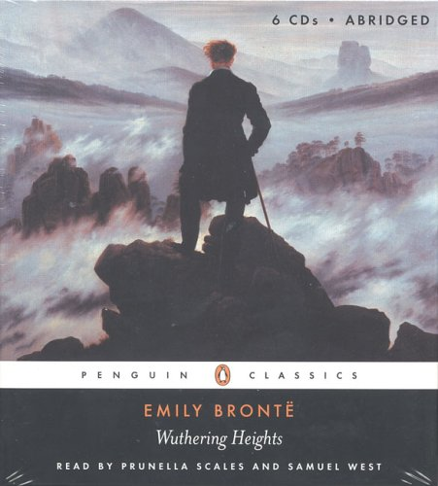
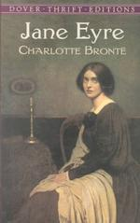
Currer, Ellis, and Acton Bell:
Charlotte Brontë Emily Brontë Anne Brontë
1847
Notes:
All three sisters published novels in 1847. WH and AG together in set.
Charlotte's: "The Professor" was rejected for publication at that time. But Jane Eyre was published shortly thereafter in same year.
male pseudonyms: Currer, Ellis, and Acton Bell
Wuthering Heights--Emily's only novel
Anne: Agnes Grey - a governess’s life; The Tenant of Wildfell Hall a girl’s marriage to a rake.
Charlotte published the most: Shirley, Villette, The Professor

Slide 7
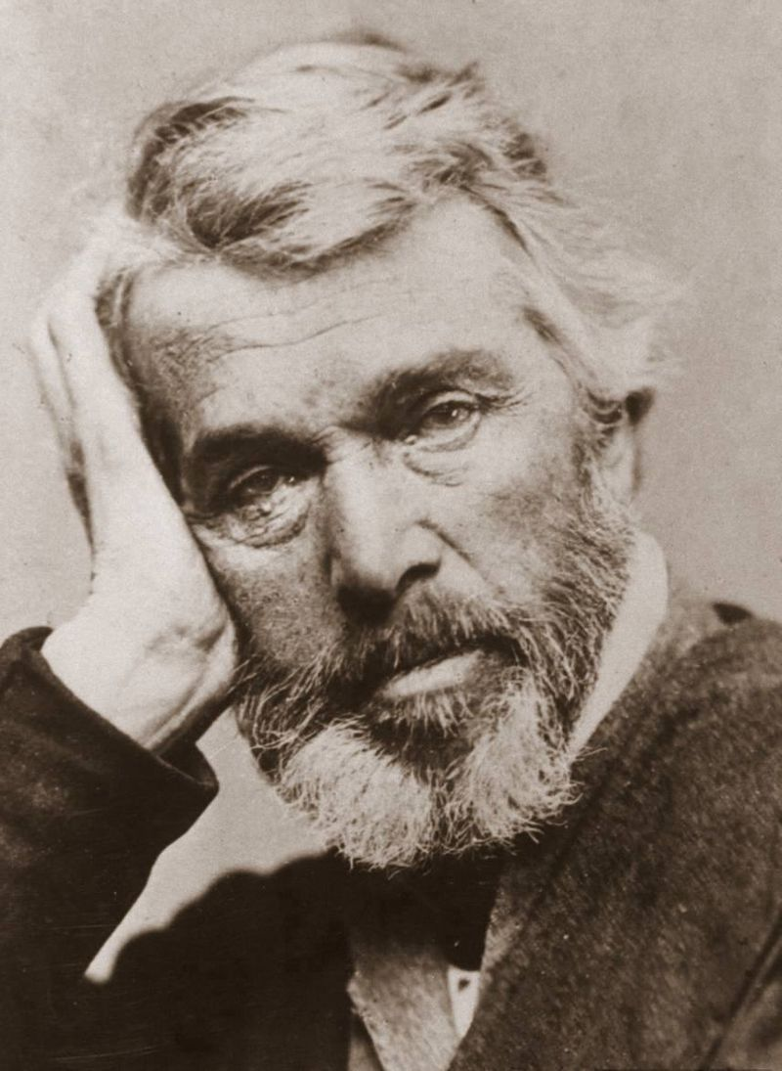
Thomas Carlyle
Scottish, prose writer of the Victorian Age
He attacked the Victorian hypocrisy and lust for materialistic gain
Industrialism and free economic policies are destroying culture, human, nature
Does not believe in democracy
Criticizes poverty, personal profit over social welfare

Slide 8
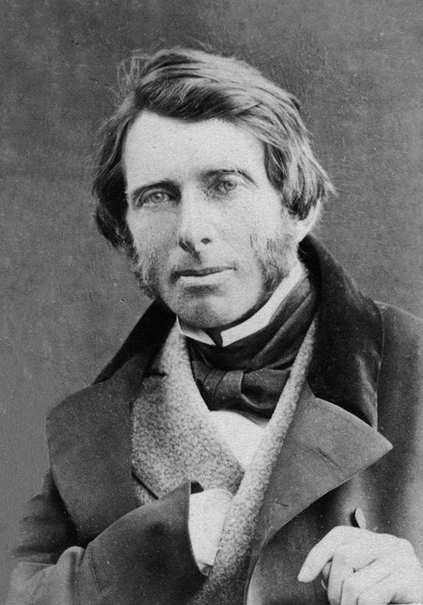
John Ruskin
Ruskin was also a social reformer.
• He had the greatest sympathy for the workman and the labourer;
• He advocated:
• some form of socialism,
• a system of education,
• a better organization of labour and other social reforms
. • He openly criticized the doctrine of laissez-faire and continuously preached against industrialism as the destroyer, through degrading mass production, of “pleasure in the work”.
• Therefore, his approach was, often that of an aesthete.
• He can be considered the spiritual father of the Pre-Raphaelite movement and in part the forerunnerof the aesthetic movement .

Slide 9
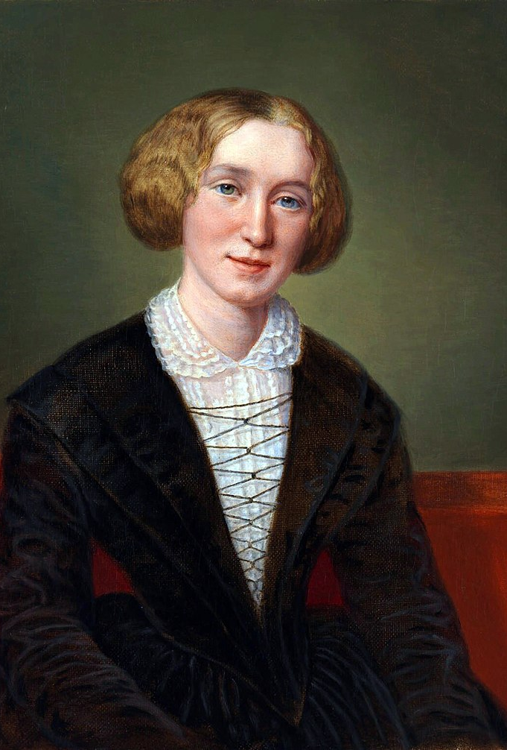
George Eliot, Mary Ann Evans
Mary Anne Evans was one of the best writers in the Victorian era because of her simplistic writing style and how she was the first to write fictional stories depicting issues and problems of society instead of the everyday fairytale. She created a style in its own called realism which changed literature forever.
Adam Bede, 1859
The Mill on the Floss, 1860
Silas Marner, 1861
Romola, 1863
Felix Holt, the Radical, 1866
Middlemarch, 1871–72
Daniel Deronda, 1876

Slide 10
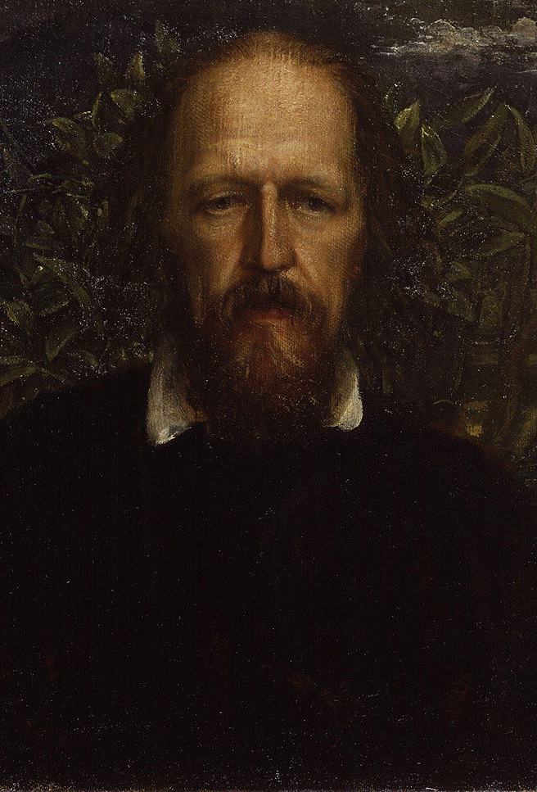
Alfred Tennyson, Lord Tennyson
Recognized as greatest poet of Victorian England for more than fifty years • Intensely private and introspective
• Personal and subjective moods and states of mind in poetry
• Known for division between public and private selves • Educated his children at home; disturbed and terrified them with his emotional instability
• Father was an educated but depressed Reverend
• Grew up sensitive, well-read, but melancholy
• Loved brothers and sisters, but spent much time alone
• Began writing and publishing poetry anonymously before he was ten

